Slide 1
Lecture 2
Naive Gauss Elimination

Slide 2
Gauss elimination methods
Even a closed form solution of systems of linear equations is known in form of Cramer’s rule, the practical application of it is very limited
Gauss elimination aims to transform the system of linear equations in an equivalent system that can be solved in very short time
This is done by a systematic procedure replacing equations by new ones obtained by multiplication and subtraction of equations from the original system
Notes:
In last lecture we discussed linear systems of equations
We learned that there is a closed form solution which can be given by Cramer’s rule
However Cramer’s rule involve the calculation of several determinants resulting in high calculation times.
Unless we develop an efficient way to compute such determinants, the closed form solution is of very limited practical use.
An alternative approach is to transform the original system of equations into another one, simpler and faster to solve
One of such approaches is the Gauss elimination strategy.
Gauss elimination transform a system into a simpler one by a systematic procedure replacing equations by new ones obtained by multiplication and subtraction of equations from the original system

Slide 3
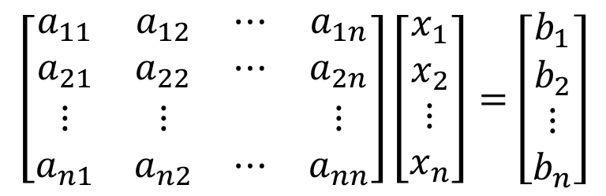
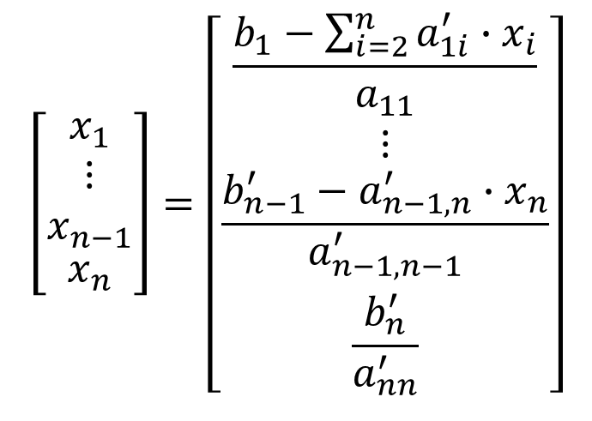
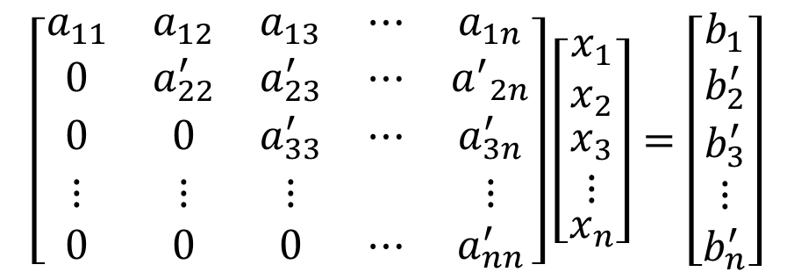
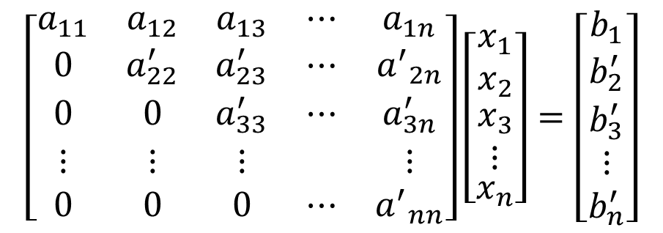
General idea
$$\left[\begin{matrix}a_{11} & a_{12} & a_{13} & ⋯ & a_{1n} \\ 0 & a_{22}^{′} & a_{23}^{′} & ⋯ & {a^{′}}_{2n} \\ 0 & 0 & a_{33}^{′} & ⋯ & a_{3n}^{′} \\ ⋮ & ⋮ & ⋮ & & ⋮ \\ 0 & 0 & 0 & ⋯ & {a^{′}}_{nn}\end{matrix}\right]\left[\begin{matrix}x_{1} \\ x_{2} \\ \begin{aligned}x_{3} \\ ⋮\end{aligned} \\ x_{n}\end{matrix}\right]=\left[\begin{matrix}b_{1} \\ \begin{aligned}b_{2}^{′} \\ b_{3}^{′}\end{aligned} \\ ⋮ \\ b_{n}^{′}\end{matrix}\right]$$
$$\left[\begin{matrix}a_{11} & a_{12} & ⋯ & a_{1n} \\ a_{21} & a_{22} & ⋯ & a_{2n} \\ ⋮ & ⋮ & & ⋮ \\ a_{n1} & a_{n2} & ⋯ & a_{nn}\end{matrix}\right]\left[\begin{matrix}x_{1} \\ x_{2} \\ ⋮ \\ x_{n}\end{matrix}\right]=\left[\begin{matrix}b_{1} \\ b_{2} \\ ⋮ \\ b_{n}\end{matrix}\right]$$
Forward
elimination
$$\left[\begin{matrix}x_{1} \\ \begin{aligned}⋮ \\ x_{n−1}\end{aligned} \\ x_{n}\end{matrix}\right]=\left[\begin{matrix}\frac{b_{1}−\sum_{i=2}^{n}{a_{1i}^{′}∙x_{i}}}{a_{11}} \\ ⋮ \\ \frac{b_{n−1}^{′}−a_{n−1,n}^{′}{∙x}_{n}}{a_{n−1,n−1}^{′}} \\ \frac{b_{n}^{′}}{a_{nn}^{′}}\end{matrix}\right]$$
$$\left[\begin{matrix}a_{11} & a_{12} & a_{13} & ⋯ & a_{1n} \\ 0 & a_{22}^{′} & a_{23}^{′} & ⋯ & {a^{′}}_{2n} \\ 0 & 0 & a_{33}^{′} & ⋯ & a_{3n}^{′} \\ ⋮ & ⋮ & ⋮ & & ⋮ \\ 0 & 0 & 0 & ⋯ & a_{nn}^{′}\end{matrix}\right]\left[\begin{matrix}x_{1} \\ x_{2} \\ \begin{aligned}x_{3} \\ ⋮\end{aligned} \\ x_{n}\end{matrix}\right]=\left[\begin{matrix}b_{1} \\ \begin{aligned}b_{2}^{′} \\ b_{3}^{′}\end{aligned} \\ ⋮ \\ b_{n}^{′}\end{matrix}\right]$$
Back
substitution
Notes:
The idea is to transform the original system into an equivalent one having a different structure making it faster to solve
Gauss elimination aims to obtain a system in an upper diagonal form by so-called forward elimination.
An upper diagonal system is a system for which the coefficient matrix is an upper diagonal matrix.
Such a matrix has zeros in all entries below the diagonal as highlighted with the triangle on the slide
Such an upper diagonal system is much faster to solve.
The solution process starts with the last equation, which contains only a single unknown
Using the result found it solves the second last equation, which its turn contain now as well only one unknown
One proceed likes this further until the first equation
This process is called back substitution or sometimes back solving.
Explained in a general way the complete process seems rather complex. But in fact it is really simple as we will see in the coming examples.

Slide 4
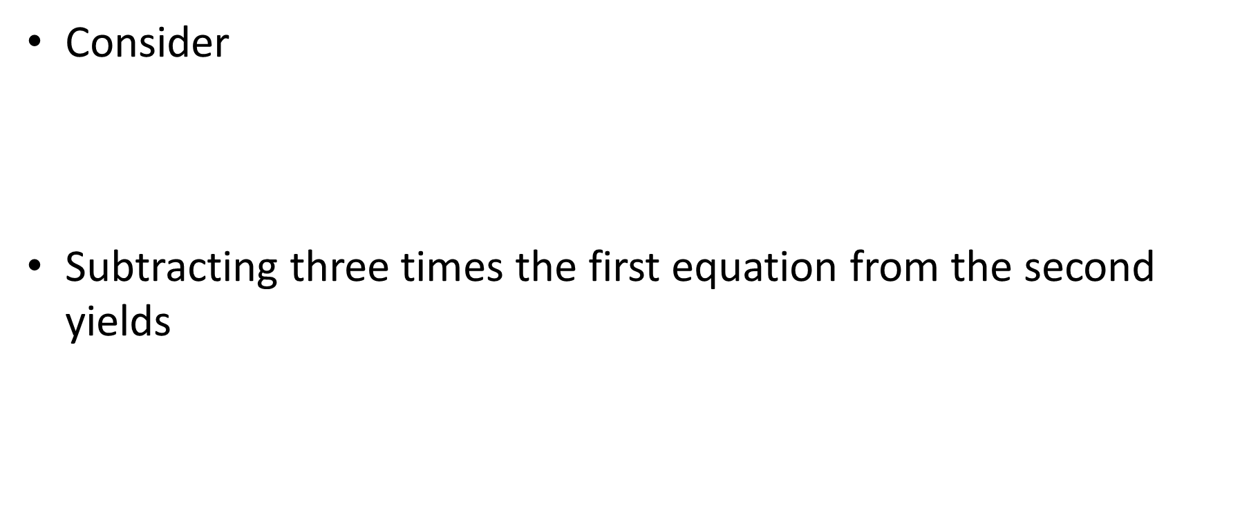
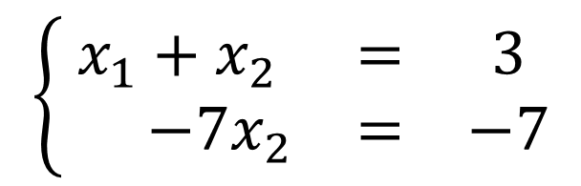
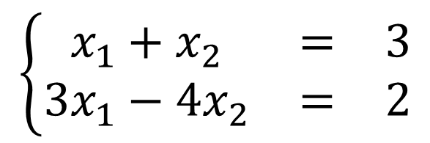
Example with two equations
Consider
Subtracting three times the first equation from the second yields
$$\left\{\begin{matrix}x_{1}+x_{2} & = & 3 \\ 3x_{1}−4x_{2} & = & 2\end{matrix}\right.$$
$$\left\{\begin{matrix}x_{1}+x_{2} & = & 3 \\ −7x_{2} & = & −7\end{matrix}\right.$$
Notes:
Let us use a system with only two equations to explain the Gauss elimination procedure
First we try to replace the second equation by another one containing only a single unknown
This can be achieved by creating a new equation by subtracting three times the first equation from the second one.
This way we get a new equivalent system as shown on the slide.

Slide 5



Example of a two equations
Solve
We first solve the last equation:
And then the first one:
$$\left\{\begin{matrix}x_{1}+x_{2} & = & 3 \\ −7x_{2} & = & −7\end{matrix}\right.$$
$$x_{2}=1$$
$$x_{1}+1=3⇒x_{1}=2$$
Notes:
This system is now very fast to solve
The second equation is straight forward to solve and we find x2=1
Using x2=1, the first equation is straight forward to solve too and we find x1=2.

Slide 6
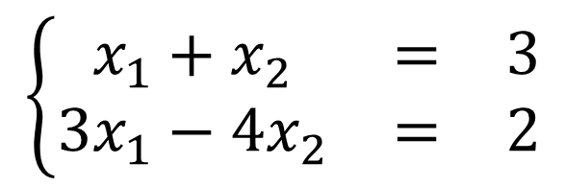



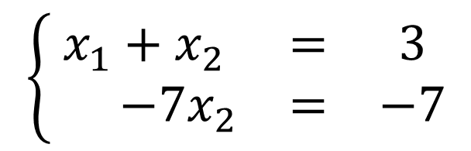
Remark
There are various ways to form an upper triangular system
$$\left\{\begin{matrix}x_{1}+x_{2} & = & 3 \\ 3x_{1}−4x_{2} & = & 2\end{matrix}\right.$$
$$r_{2}←R_{2}−3R_{1}$$
$$\left\{\begin{matrix}x_{1}+x_{2} & = & 3 \\ −7x_{2} & = & −7\end{matrix}\right.$$
Used in Gauss elimination
$$\left\{\begin{matrix}x_{1}+x_{2} & = & 3 \\ 3x_{1}−4x_{2} & = & 2\end{matrix}\right.$$
$$r_{2}←{3R_{1}−R}_{2}$$
$$\left\{\begin{matrix}x_{1}+x_{2} & = & 3 \\ 7x_{2} & = & 7\end{matrix}\right.$$
Notes:
Of course there are several ways to transform the original system of equation into an upper diagonal system
Two examples are shown on the slide.
The Gauss elimination algorithm uses the first option.
The way to find how Gauss elimination proceeds is to ask yourself the following question:
How many times do I have to remove the first equation from the second one in order to remove the first unknown x1.
In the present example the answer is that we have to remove 3 times the first equation from the second in order to cancel out the unknown x1.
This is exactly the operation that the Gauss elimination algorithm will apply.

Slide 7



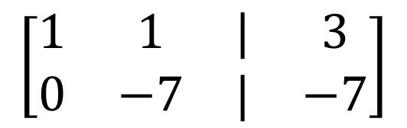
Augmented matrix notation
A common notation is:
Solving leads to
$$\left[\begin{matrix}1 & 1 & | & 3 \\ 3 & −4 & | & 2\end{matrix}\right]$$
$$r_{2}←R_{2}−3R_{1}$$
$$\left[\begin{matrix}1 & 1 & | & 3 \\ 0 & −7 & | & −7\end{matrix}\right]$$
Pivot element
We want to get a 0 here
$$\underline{x}=\left[\begin{matrix}2 \\ 1\end{matrix}\right]$$
Notes:
A simpler way to present the calculations is the so-called augmented matrix notation
In this notation one creates a table out of the coefficient matrix A and the right hand side vector b as shown on the slide.
To proceed with the first Gauss elimination step one starts by identifying the so-called pivot element
This is the coefficient of the first unknown of the first equation
The equation containing the pivot element will be called the pivot equation.
The Gauss elimination aims to create a zero below the pivot element.
To obtain this 0, one asks the question:
how many times do I have to remove the pivot equation form the second to remove the first unknown from the second equation.
The answer to this question leads to the Gauss elimination step which in our example is R2-3*R1.
Proceeding with this step results in the new table as shown
From this last table it is straight forward to compute x2 and then x1.

Slide 8
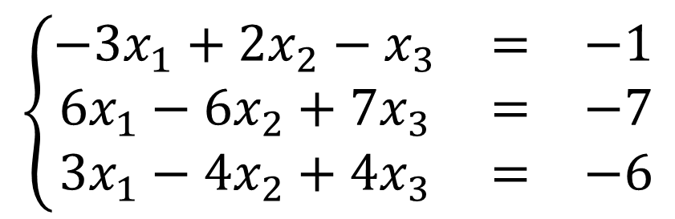

Example with three equations
Consider
Augmented matrix notation
$$\left\{\begin{matrix}−3x_{1}+{2x}_{2}−x_{3} & = & −1 \\ 6x_{1}−6x_{2}+7x_{3} & = & −7 \\ 3x_{1}−4x_{2}+4x_{3} & = & −6\end{matrix}\right.$$
$$\left[\begin{matrix}−3 & 2 & −1 & | & −1 \\ 6 & −6 & 7 & | & −7 \\ 3 & −4 & 4 & | & −6\end{matrix}\right]$$
Notes:
Now that we understand the mechanism for two equations, let us see how the algorithm handles three equations
Consider the system shown
First we write it into the augmented matrix notation.

Slide 9







Example with three equations
Solving:
$$\left[\begin{matrix}−3 & 2 & −1 & | & −1 \\ 6 & −6 & 7 & | & −7 \\ 3 & −4 & 4 & | & −6\end{matrix}\right]$$
$$\left[\begin{matrix}−3 & 2 & −1 & | & −1 \\ 0 & −2 & 5 & | & −9 \\ 0 & −2 & 3 & | & −7\end{matrix}\right]$$
$$r_{2}←R_{2}−\left(−2\right)R_{1}$$
$$r_{3}←R_{3}−\left(−1\right)R_{1}$$
$$\left[\begin{matrix}−3 & 2 & −1 & | & −1 \\ 0 & −2 & 5 & | & −9 \\ 0 & −2 & 3 & | & −7\end{matrix}\right]$$
$$\left[\begin{matrix}−3 & 2 & −1 & | & −1 \\ 0 & −2 & 5 & | & −9 \\ 0 & 0 & −2 & | & 2\end{matrix}\right]$$
$$r_{3}←R_{3}−R_{2}$$
Notes:
Next we identify the pivot element, -3 in or case.
Observing the table gives us the two Gauss elimination steps to eliminate the unknown x1 in the equations below the first one
Keep in mind to ask:
How many times I have to remove the pivot equation from the second, respectively third one to eliminate x1 from these equations
The answer leads to the correct Gauss elimination steps which are in our case
R2 – (-2)*R1
And
R3-(-1)*R1
Having identified the needed operations to eliminate the unknown x1 from the second and third equation, we can proceed to write the new equivalent system of equation
The first equation remains unchanged
Then we execute the first identified row operation to create the new second equations
And we finish by executing the second identified row operation to create the new third equation.
We obtain a new system of equation
This is not yet an upper diagonal system
To transform it into an upper diagonal system, one more Gauss elimination step needs to be done
For this we look to the subsystem highlighted and proceed exactly same way as before
The pivot element is -2
To eliminate the second unknown x2, the question to ask is :
How many times do I have to remove the second equation, the one with the pivot element, from the third one to eliminate x2?
The answer is that we need to remove 1 times R2 from R3 to eliminate x2.
We can now start to write our new equivalent system of equation
The equations one and two are unchanged
The new third equation is obtained by executing the identified row operation
This leads us to our upper diagonal matrix

Slide 10


Example with three equations
Back substitution
$$\left[\begin{matrix}−3 & 2 & −1 & | & −1 \\ 0 & −2 & 5 & | & −9 \\ 0 & 0 & −2 & | & 2\end{matrix}\right]$$
$$\underline{x}=\left[\begin{matrix}2 \\ 2 \\ −1\end{matrix}\right]$$
Back substitution
Notes:
Solving the system is done by back substitution
Form the last equation we get right away x3=-1
Using this result in the second equation allows us to compute x2 to be equal to 2
Knowing x2 and x3, allows us to compute x1 from the first equation.
We find x1=2.
The procedure we explained can be generalized to as many equations as we want.
The principle remains always the same.

Slide 11
Summary
Naive Gauss elimination is a systematic strategy to solve systems of linear equations
It first transforms the system into an upper diagonal systems
And second solves it by back substitution
Notes:
Let us summarize the key findings
Naive Gauss elimination is a systematic strategy to solve systems of linear equations
It first transforms the system into an upper diagonal systems
And second solves it by back substitution

